Slide 1
Lakeflow Spark Declarative Pipelines (SDP)

Slide 2
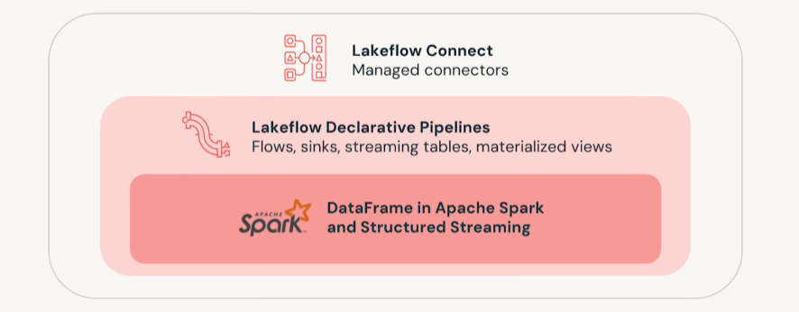
Lakeflow SDP
Lakeflow connect is not enabled in the Databricks COP.
Structured streaming is used for real time streaming (not an available use case at this time)
This demo will concentrate solely on Lakeflow Declarative Pipelines

Slide 3
What are Lakeflow Spark Declarative Pipelines?
SDP in Databricks is a declarative framework for building and running batch and streaming data pipelines using Spark SQL or Python.
You declare the desired data transformations and outputs (tables, views, sinks) in the form of expectations
SDP automatically handles execution order, parallelism, incremental processing, and failure retries.
Dependency on Databricks serverless compute
Implement streaming tables and materialized views
[PENDING IRS validation]

Slide 4
Lakeflow Spark Declarative Pipelines
Main Concepts
Flows – Core processing units (batch or streaming) that read from sources, apply logic, and write to targets.
Streaming Tables – Unity Catalog managed tables with continuous ingestion (Append or AUTO CDC).
Materialized Views – Batch targets that process only new/changed data.
Sinks – External streaming targets like Delta tables, Kafka, EventHubs, or custom Python outputs.
Pipelines – The top-level execution unit containing flows, tables, views, and sinks.

Slide 5
Lakeflow Spark Declarative Pipelines
Key Benefits
Automatic orchestration of flows with retries at task, flow, and pipeline levels.
Declarative processing that reduces complex Spark/Structured Streaming code to a few lines.
Incremental processing for materialized views to avoid reprocessing unchanged data.
Built-in CDC handling via AUTO CDC for SCD Type 1 & 2 without manual watermark/event ordering logic.

Slide 6
Universal Application Programming Interface UAPI
A Unified API is an innovative type of application programming interface (API) designed to empower developers with seamless access to information from multiple sources through a single interface. In simpler terms, a unified API streamlines and accelerates the process of fetching data from diverse databases, applications, systems, and even different APIs.

Slide 7
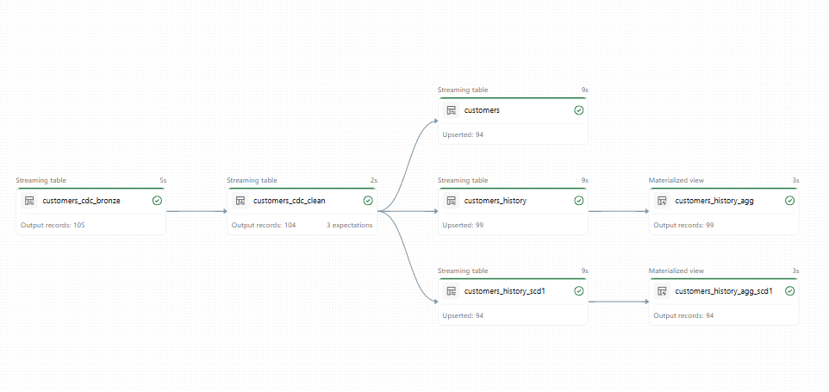
SCD2
SCD1

Slide 8
Lakeflow Declarative pipelines Demo

Slide 9
Structured Streaming
Structured Streaming is an API for incremental stream processing in near real-time. It provides strong performance, scalability, and fault tolerance.
Delta table streaming reads and writes
SCD1
SCD2

Slide 10
Structured Streaming Demo

Slide 11
Lakeflow declarative pipelines
Lakeflow Spark Declarative Pipelines builds on Structured Streaming, offering a declarative framework for creating data pipelines. You can define the transformations to perform on your data, and Lakeflow Spark Declarative Pipelines manages orchestration, monitoring, data quality, errors, and more. Therefore, it offers more automation and less overhead than Structured Streaming.

Slide 12
Lakeflow Declarative pipelines Demo

Slide 13
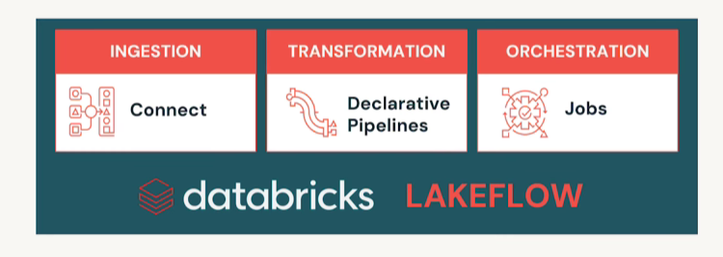
What is Lakeflow connect
Lakeflow Connect offers simple and efficient connectors to ingest data from local files, popular enterprise applications, databases, cloud storage, message buses, and more.
Option | Description
A fully-managed service | Out-of-the-box connectors that democratize data access with simple UIs and powerful APIs.
Fully-managed connectors build on Lakeflow Spark Declarative Pipelines, offering even more automation for the most popular data sources. They extend Lakeflow Spark Declarative Pipelines functionality to also include source-specific authentication, CDC, edge case handling, long-term API maintenance, automated retries, automated schema evolution, and so on. Therefore, they offer even more automation for any supported data sources.

Slide 14
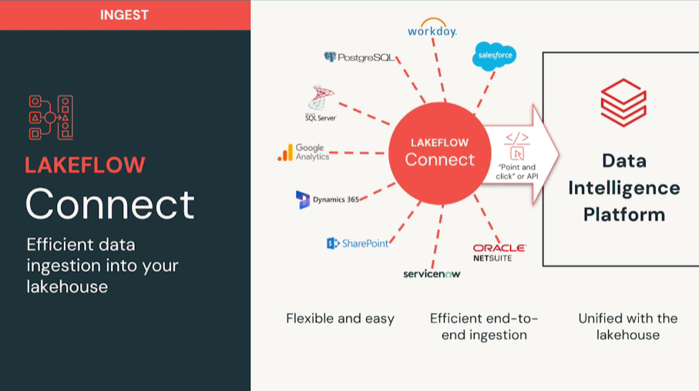
Lakeflow connect managed connectors
Fully Managed schema evolution
Lowers maintenance cost
Lowers time to value

Slide 15
Lakeflow Connector Demo

